Slide 1
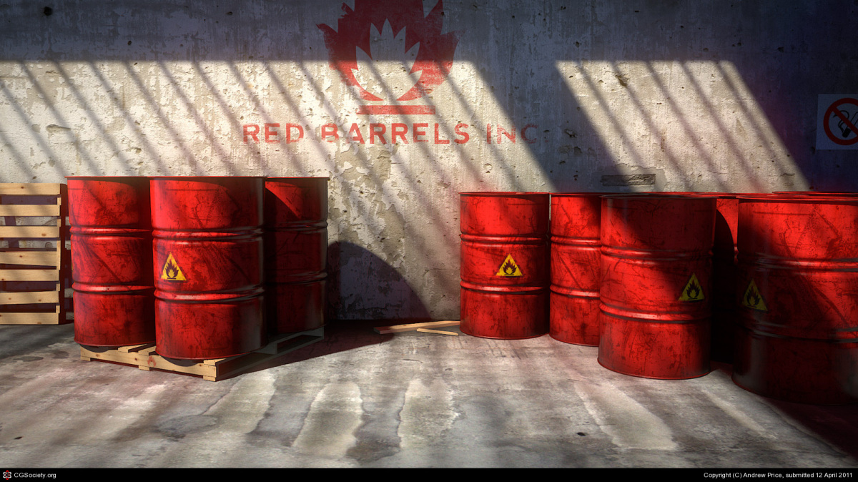
Game Technology
Lecture 8 – 5.12.2014
Physics 1
Dr.-Ing. Florian Mehm
Dipl-Inf. Robert Konrad

Slide 2
Preliminary timetable
Lecture No. | Date | Topic
1 | 17.10.2014 | Basic Input & Output
2 | 24.10.2014 | Timing & Basic Game Mechanics
3 | 31.10.2014 | Software Rendering 1
4 | 07.11.2014 | Software Rendering 2
5 | 14.11.2014 | Basic Hardware Rendering
6 | 21.11.2014 | Animations
7 | 28.11.2014 | Physically-based Rendering
8 | 05.12.2014 | Physics 1
9 | 12.12.2014 | Physics 2
10 | 19.12.2014 | Procedural Content Generation
11 | 16.01.2015 | Compression & Streaming
12 | 23.01.2015 | Multiplayer
13 | 30.01.2015 | Audio
14 | 06.02.2015 | Scripting
15 | 13.02.2015 | AI

Slide 3
Overview
Today
As easy as possible
Build a simple demo with
Particle system
Colliding spheres
Understand the basic principles
Next week
Build upon what we have learned
Look at more complicated case
Apply the physics to our game

Slide 4
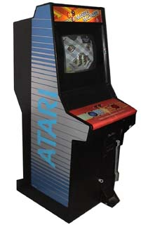
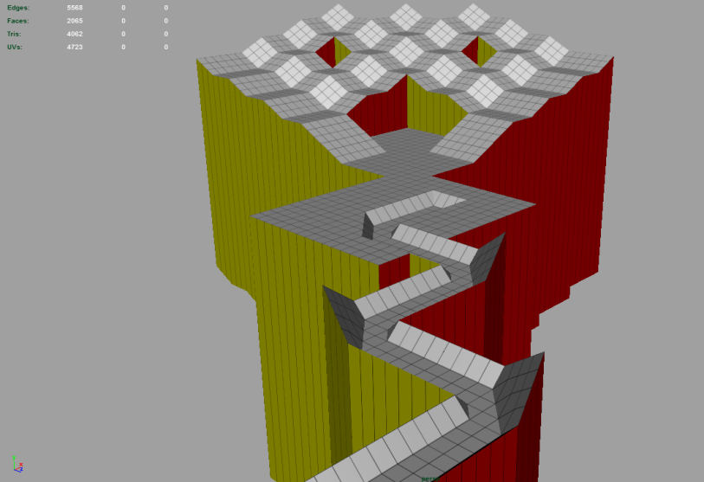
Where we are headed
„Marbellous“
Clone of „Marble Madness“ (1984)
Roll a marble through a maze
Ball Physics
Apply force based on key inputs
Bounce off off the level geometry
(Fall from too high)
Level
Provided as a mesh
„2D in 3D“

Slide 5
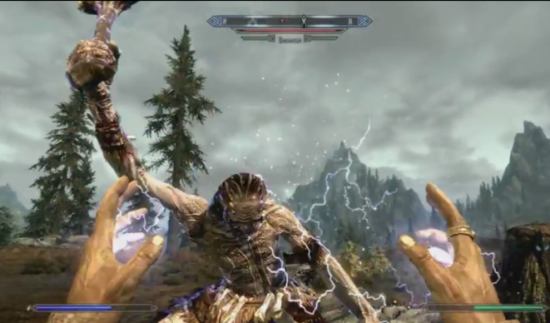
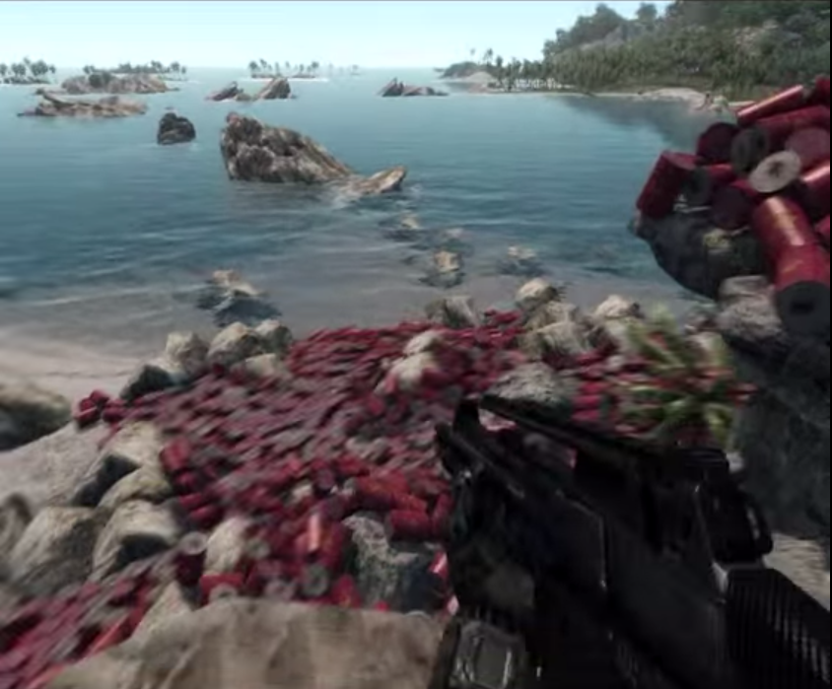
Physics gone wrong…
Skyrim
https://www.youtube.com/watch?v=O2UDHkTITMk
Skate 3
https://www.youtube.com/watch?v=UaUR6u8nHoM
Assassin‘s Creed
https://www.youtube.com/watch?v=WyovOrA64B8
Crysis
https://www.youtube.com/watch?v=YG5qDeWHNmk

Slide 6
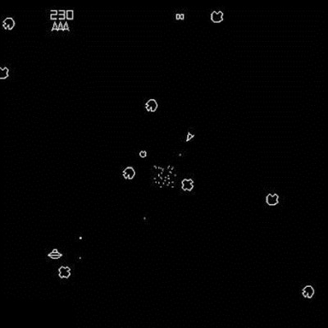
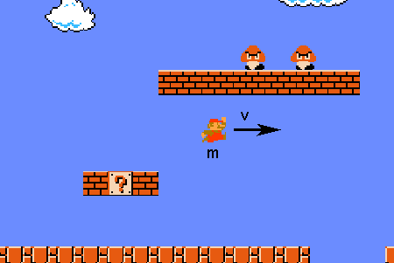
Physics History
Special-Purpose Physics
Like the games, built for one purpose/game
E.g. Asteroids, Marble Madness, …
Built for enjoyment and good gameplay feeling
Physical accuracy not important
E.g. Mario’s momentum and friction

Slide 7
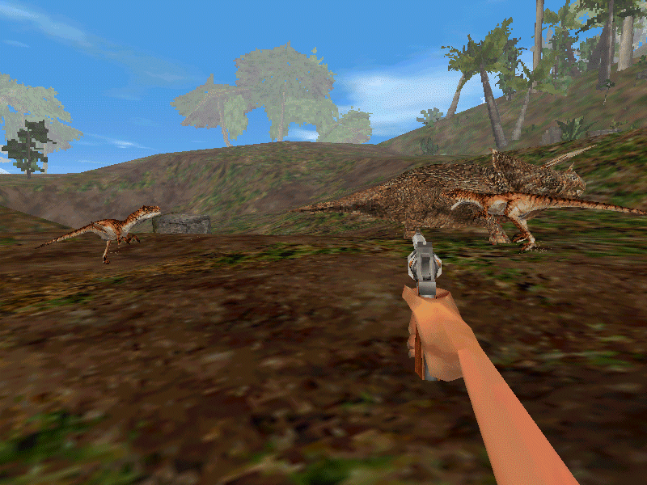
Physics History
3D Physics
Now more important to get realistic feel
Started out with solutions developed in-house
E.g. Trespasser (1998), own engine
Ragdoll Physics
Physical Simulation for articulated bodies
Previously only for unconcious characters
Now mixed with forward kinematics

Slide 8



General-Purpose Physics
Libraries – Re-usable for different games
Bullet
Box2D
…
Hardware Acceleration
Nvidia Physx
Uses CUDA General-Purpose GPU Calculations
E.g. for particle systems

Slide 9
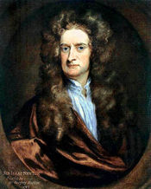
Newtonion Physics
Isaac Newton
1643 - 1727

Slide 10
Newton’s three laws
Every object in a state of uniform motion tends to remain in that state of motion unless an external force is applied to it.
The relationship between an object's mass m, its acceleration a, and the applied force F is F = ma. Acceleration and force are vectors (as indicated by their symbols being displayed in slant bold font); in this law the direction of the force vector is the same as the direction of the acceleration vector.
For every action there is an equal and opposite reaction.

Slide 11
Law #1
Every object in a state of uniform motion tends to remain in that state of motion unless an external force is applied to it.
Examples of forces
Gravity
Drag
Explosions
…
If we have an object that is just floating in space, simulation is very easy
Just continue with the same velocity in the same direction

Slide 12
Law #2
The relationship between an object's mass m, its acceleration a, and the applied force F is F = ma. Acceleration and force are vectors (as indicated by their symbols being displayed in slant bold font); in this law the direction of the force vector is the same as the direction of the acceleration vector.
Mass m
Measures the mass, not the weight
The property that resists changes in linear or angular velocity
Acceleration a
Measure of the change of velocity
Force m

Slide 13
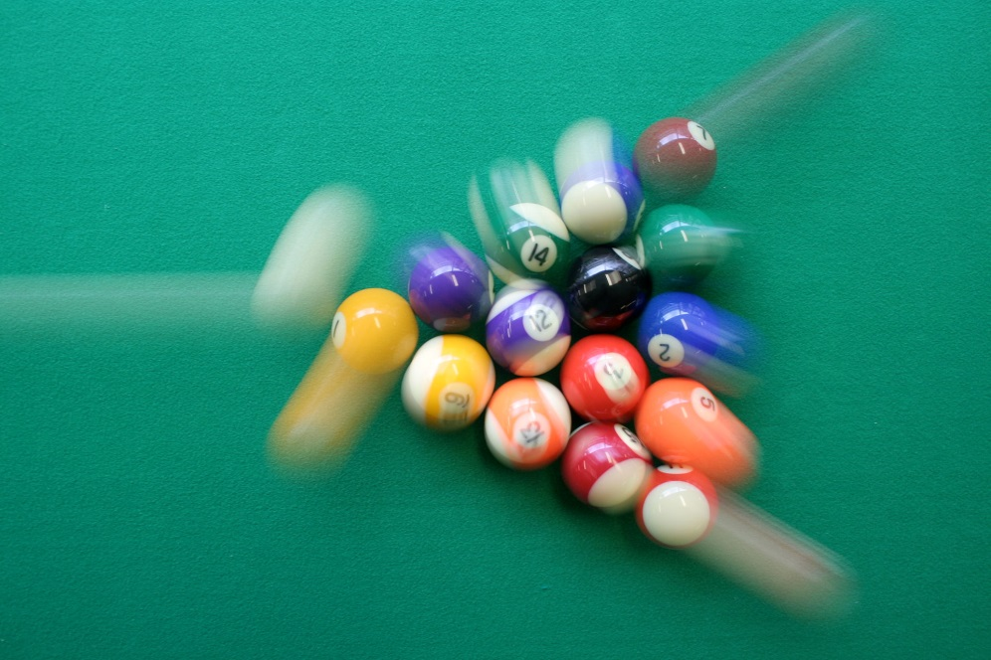
Law #3
For every action there is an equal and opposite reaction.
We need to take care of this when we are simulating collisions
Collision Detection
Collision Response
→ This is where the fun begins ;-)

Slide 14
D‘Alamberts Prinicple
Forces being applied to an object add up (Vector sums)
Will save us computational time and make code more readable
Calculating the effect of each force individually
Vs
Accumulating forces and calculating the effect of the sum of the forces
F2
F1
F3
F1+F2+F3
F2
F1
F3

Slide 15
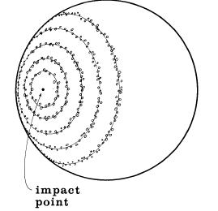
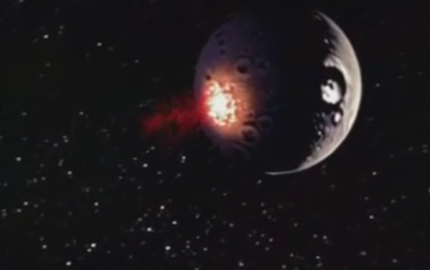
Particle Systems
Particle
Infinitisemally small object
→No need to calculate rotations, forces off-center
→No volume
Origins
William T. Reeves: „Particle Systems A Technique for Modeling a Class of Fuzzy Objects” (1983
Worked on “Star Trek 2 – The Wrath of Khan”

Slide 16
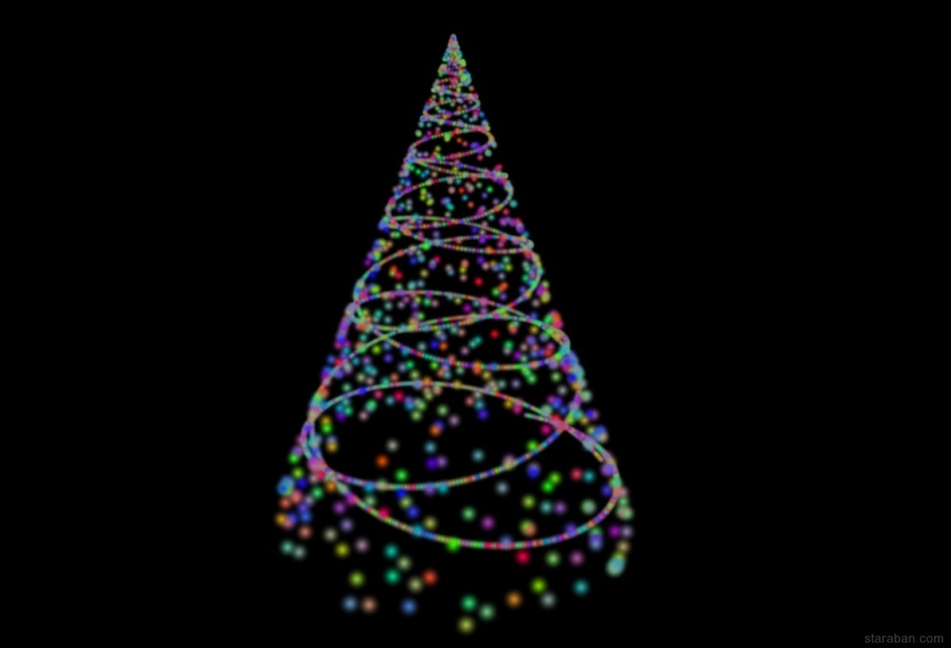
Particle Systems
Use in Games today
Gaseous effects
Fire
Smoke
Gasses
Explosions
Atmospheric effects
Basis for advanced techniques
Cloth simulation
Hair simulation
Fluid simulation

Slide 17
Particle Systems
Emitter
Geometric shape in which the particles are spawned
Spheres
Boxes
Complex polyhedra (meshes)
Planes
…
Emission Control
Position (on faces, vertices, edges, inside the volume, …)
Random positioning of the emitted particles
Number of particles
Initial velocity
Other particle properties
Center

Slide 18
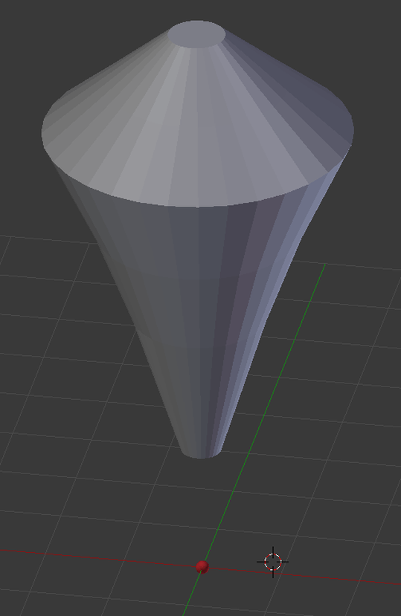
Example – Particle systems shaping objects
Goal: Render an amorphous/gaseous “alien”
Two particle systems
One emits particles that are rendered, no gravity
One emits invisible particles
From the shape of the mesh
No velocity, no gravity
Brownian motion
Act as attractors for the other particles

Slide 19
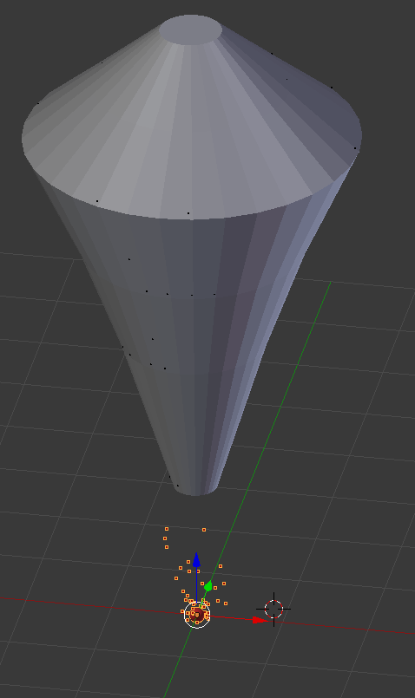
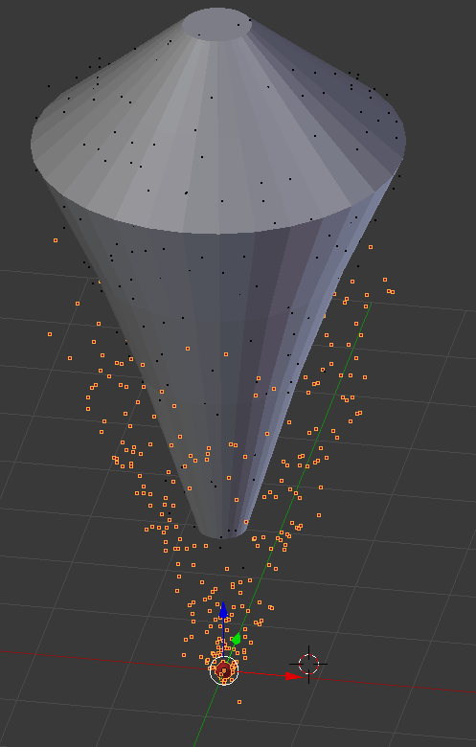
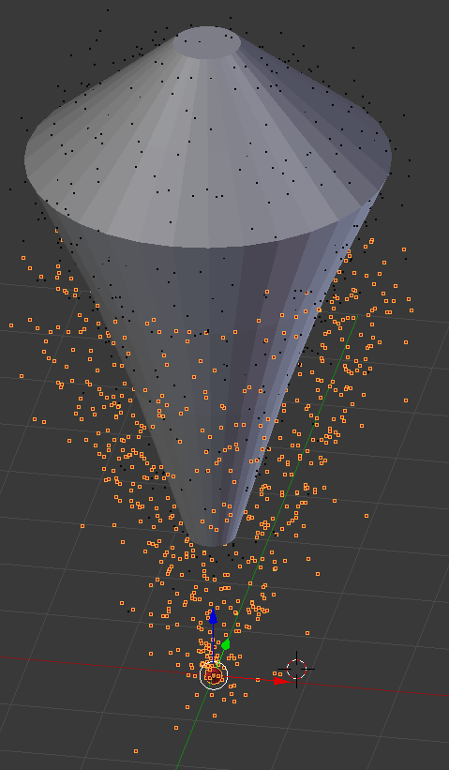
Example contd.

Slide 20







Example contd.

Slide 21
Particle system control parameters
Initial position
Jittering – amount of randomness
Spawn rate
The rate itself
Changes over time
All at once, over a certain time, continuuously, maximal number of particles, …
Initial direction & velocity
Direction (straight up, sidewards, …)
Velocity
Gravity

Slide 22

Particle system control parameters
Other forces
Wind
Player interaction
…
Time to live
2nd and further levels
Spawn new particles at the end of the life cycle
E.g. used for fireworks
Animation
Control shape, size, transparency, sprite or any other parameter over time

Slide 23
Rendering Particles
Billboards
Textures with (alpha) textures
Simple geometry (can be instanced)
Rotating the particles to the camera
Use the inverse of the view matrix
View matrix is usually Translation and Rotation
We only care about the rotation part
→ Orthogonal matrix, can be inverted by transposing
Depth-Sorting the particles
Use the transformed z-value of the particle
Sometimes not necessary – can be a performance setting
Trails

Slide 24
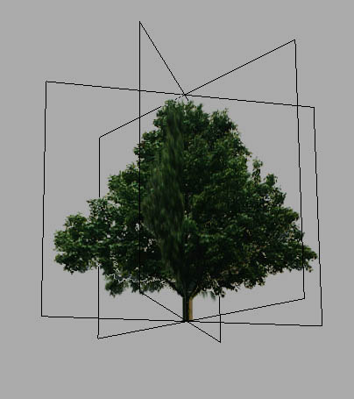
Types of Billboards
Quads
Oriented towards the camera
In all directions (e.g. particles)
Only in one axis (e.g. vertical objects such as trees)
Several quads
Placed around central axes
E.g. for trees, bushes (vertical)
Or beams (along the central axis)
Not oriented towards the camera → one side always visible to a certain degree

Slide 25
Particle Properties by Reeves
(1) initial position,
(2) initial velocity (both speed and direction),
(3) initial size,
(4) initial color,
(5) initial transparency,
(6) shape,
(7) lifetime

Slide 26
Example: Fire
Gravity: Little to none (fire moves upward)
Lifetime: Such that the flames do not rise unrealistically high
Emission: Continuously
Texture: Simple texture with alpha (to get round look)
Tint
Control parameter that can be animated over the lifetime of the particle
Color value
Simple case: Color 1 at birth, Color 2 at death
More complicated cases: Provide intermediate key colors
Supply to shader via a uniform
Discard the rgb values of the texture
Write the tint-color as rgb and use alpha from the texture

Slide 27
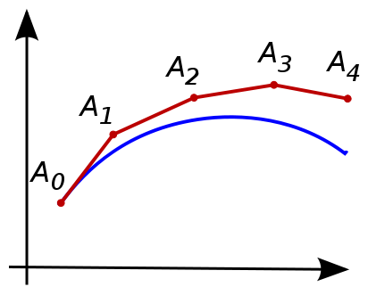
Integration for particles
We need to simulate the effect of forces on the particles
Closed solution not tractable for real-time interaction and especially player interactions
Numerical integration
Simplest approach: Euler integration

Slide 28
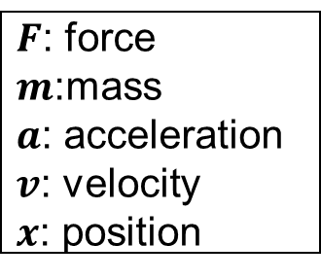
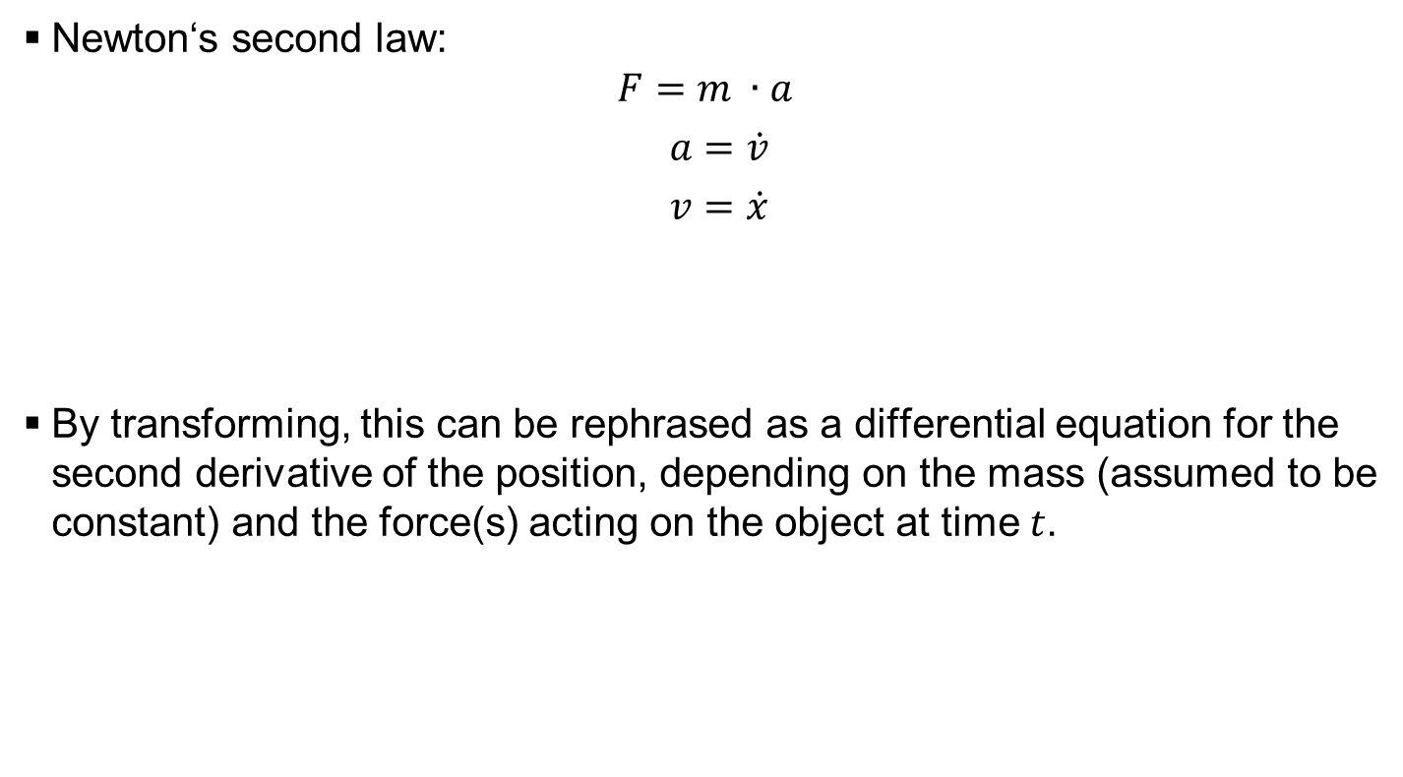
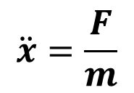
Apply Newton‘s second law
Newton‘s second law:
$$F=m ∙a$$
$a=\dot{v}$
$v=\dot{x}$
By transforming, this can be rephrased as a differential equation for the second derivative of the position, depending on the mass (assumed to be constant) and the force(s) acting on the object at time $t$.
$F$: force
$m$:mass
$a$: acceleration
$v$: velocity
$x$: position
$$\ddot{x}=\frac{F}{m}$$

Slide 29
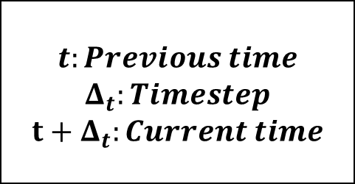
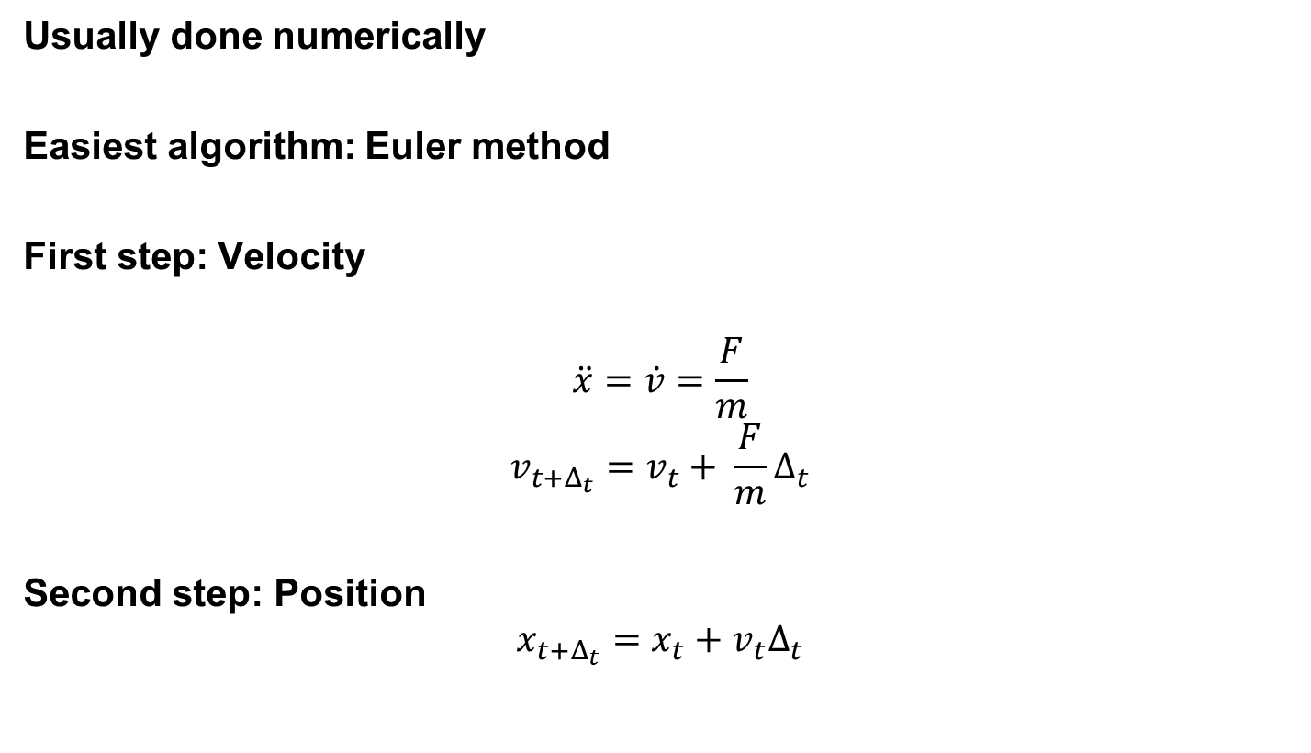
Solve the differential equation
Usually done numerically
Easiest algorithm: Euler method
First step: Velocity
$$\ddot{x}=\dot{v}=\frac{F}{m}$$
$$v_{t+Δ_{t}}=v_{t}+ \frac{F}{m}Δ_{t}$$
Second step: Position
$$x_{t+Δ_{t}}=x_{t}+v_{t}Δ_{t}$$
$$t:Previous time$$
$$Δ_{t}:Timestep$$
$${t+Δ}_{t}:Current time$$

Slide 30
Time
With game‘s frame rate
Update each frame
Keep track of the last frame time
Only an approximation of the next frame‘s duration
Watch out for paused game (e.g. tabbed out of the window)
Independent
Simulate independent of frame rate
Sub-frame calculations → more exact
Can adapt
If nothing happens, use large time step
Go to important moments (collisions)
t1
t2
deltaT

Slide 31
Time source
High Precision Event Timer (HPET)
Found in chipsets starting in 2005
64 bit counter
Counts up with a frequency of at least 10 MHz
OS sets up an interrupt with a certain frequency
Getting the time
Divide the counter value by the frequency
Watch out for large values (e.g. PC in standby over weeks)

Slide 32
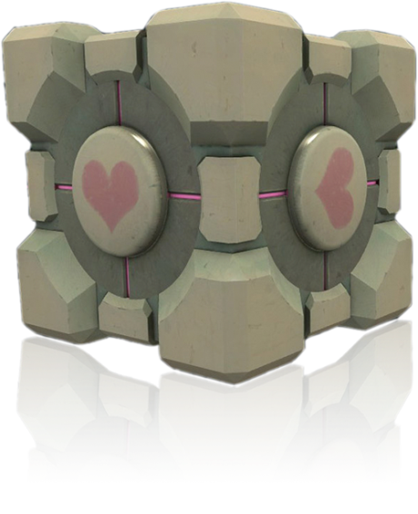
Rigid Bodies
Solid bodies that do not deform
Added properties:
Center of mass
Rotation
Angular velocity
Angular acceleration
Moment of inertia

Slide 33
Basic Terms
Mass: The property that resists changes in velocity
Center of mass
Manually: Defined by artist
Automatically: Assume uniform distribution
Integrate over the volume of the body
Force applied in line with the center of mass change only linear velocity
Easiest way to handle collisions
But not very realistic

Slide 34
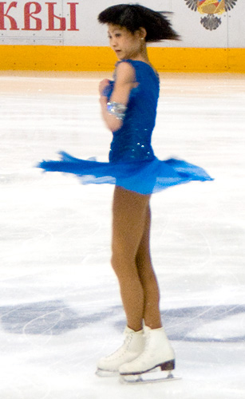
Moment of Inertia
Captures the way in which a body resists changes to angular velocity
Think of non-uniform objects
Pushing at different points leads to different results
More in the next lecture

Slide 35
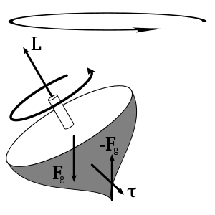
Torque
~ „Angular acceleration“
Forces that act off the center of balance
More info in next lecture

Slide 36
Computing forces for rigid bodies
Add an accumulator for torque
Separate the effects of forces, based on the point where the force is applied
Forces that push directly at the center of mass result in only linear velocity
Forces that push off-center result in linear and angular velocity
Use the cross product
Maps the force onto the vector that points at the center of mass

Slide 37
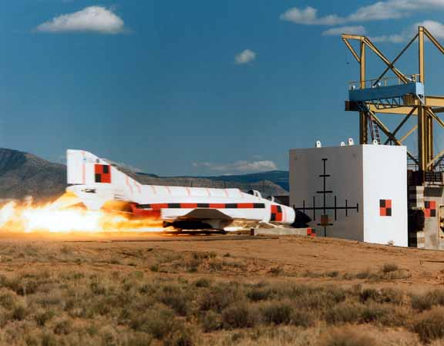
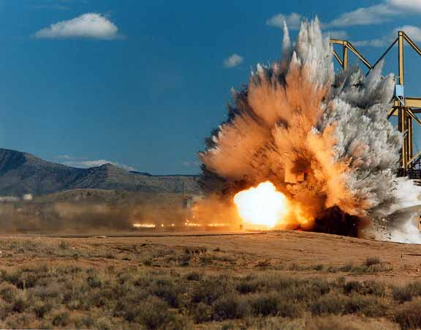
Collision Detection
Information we need to calculate a response:
Was there a collision?
What was the collision normal?
How far are the objects interpenetrating?

Slide 38
Intersection Sphere-Sphere
Easiest intersection
The spheres intersect if the distance of the centers is less than the sum of the radii
Collision normal can be found as the direction of one sphere’s center to the other
Penetration depth is the difference between the sum of the radii and the center’s position

Slide 39
Intersection Plane-Sphere
Describe the plane as
Normal
Distance along this normal
d = n * c + D
Implicit formula
Gives us a signed distance
= 0 everywhere on the surface of the plane
Distance to the plane everywhere else
Sign indicates direction (with normal, in the opposite direction)

Slide 40
Collision Response
Separate objects
In reality: Elastic collision → energy is absorbed
Approximate using coeffiction of restitution
Float between 0 and 1 → indicates the amount of speed retained after the collision
COR = 1 → No energy lost
Immovable Objects
Infinite mass
Save as inverse mass
Needed for calculations this way already
Infinite mass → Inverse mass = 0

Slide 41
Collision between two objects
Calculate the collision normal
Direction along which the two objects are colliding
Plane-Sphere: Use the plane’s normal
Sphere-Sphere (for now): Use the vector from one sphere’s center to the other’s center
Calculate the separating velocity
Velocity with which the objects are colliding plus direction
Careful with signs
Velocity < 0: Colliding
Velocity = 0: Resting/Sliding
Velocity = > 0: Separating (Nothing to do, yay ☺)

Slide 42
Collision between two objects
Calculate a new separating velocity
Using the coefficients of restitution and mass of the involved objects
Calculate an impulse that changes the velocity accordingly
Instantaneous change in velocity
In reality: Forces acting over very small times
Solve the interpenetration
Move the objects so that they are not colliding any more
Along the collision normal
With the aspect ratio of the weights involved
Immovable object (e.g. ground): Movable object has to move
Apply the impulses
= Adding to the current velocity

Slide 43
Problems – Interpenetration
Ignoring interpenetration
Just calculate separating velocity
Objects „hammer“ themselves into the ground
On each collision, the object settles a bit more into the ground
→ Move the object out of the ground

Slide 44
Problems - Bouncing
Reality – Objects do not interpenetrate
Deformation
Energy shifted between the materials
Resting Contact
Ground supports the resting object
→ Force that counters gravity
Ways to reduce/eliminate bouncing
Add an additional impulse to counter the effect of gravity in the next frame
Put objects to sleep when their energy goes low enough

Slide 45
Sleeping
In many games, most objects will be resting most of the time
They only move when a script or a player action causes them to move
Identify when objects do not need to be simulated any more
Start in a stable position (level design) and sleep initially
Recognize that the energy is low enough
Wake up again
Whenever the object takes part in the physical simulation
Identify „Islands“
Groups of objects that should wake up together
E.g. the billard balls in the start configuration

Slide 46
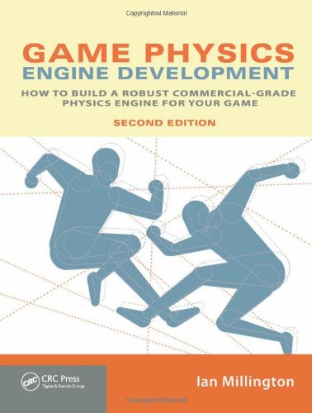
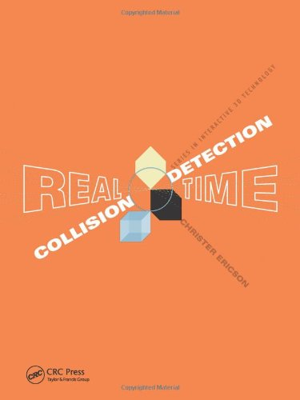
Literature
“Game Physics Engine Development”, Ian Millington
“Real-Time Collision Detection”, Christer Ericson
Box2D blog http://box2d.org/

Slide 47
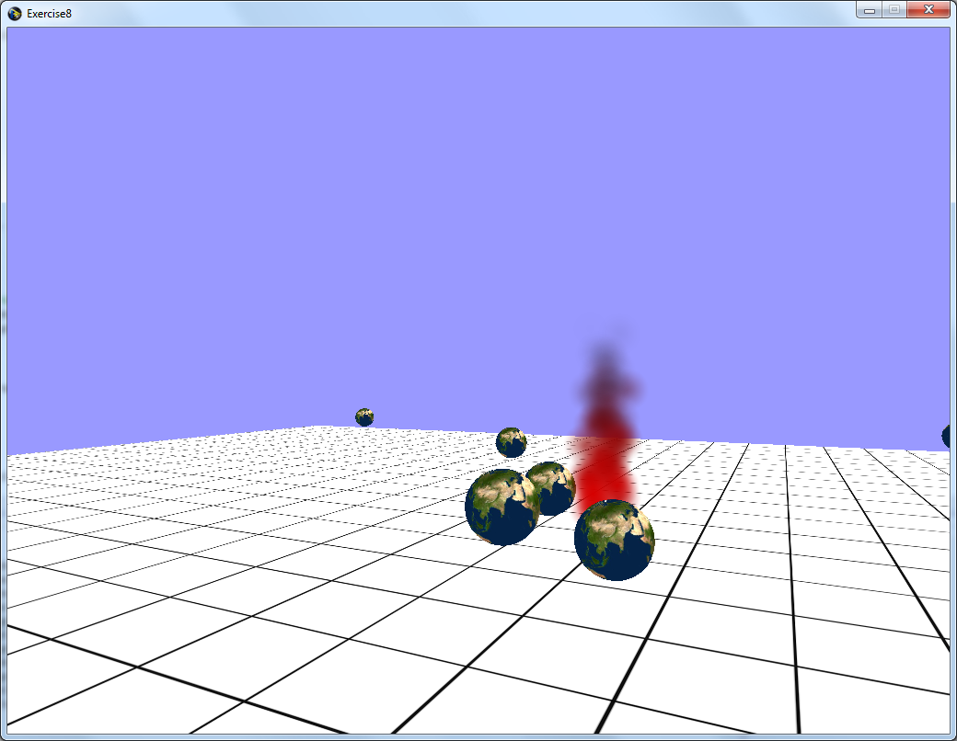
Exercise
Will be up after the lecture
Particle System
Orient billboards to the camera
Implement one new control parameter
Free choice of effect
Gas
Explosion
Rain
…
If you can’t think of anything, use the fire example

Slide 48
Exercise
Physical Simulation
Spheres are shot from the camera using Space
Very simple solution:
Bouncing of spheres is not fixed
Collision can go horribly wrong ;-)
We will post a video of the level we are ok with in this exercise

Slide 49

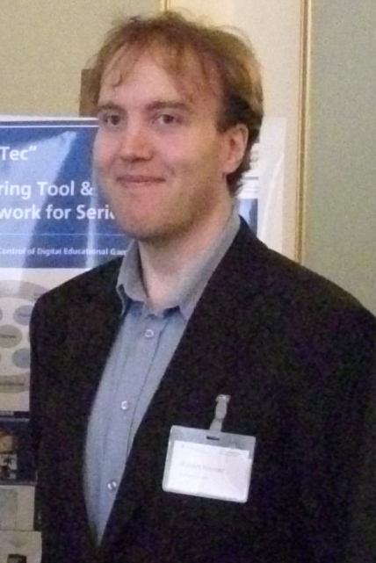


Questions & Contact
RK
game-technology@kom.tu-darmstadt.de

